Slide 1

A Tester’s Path To Robotic Process Automation
Anthony Garcia – Technical Program Manager, UiPath

Slide 2
Table of Contents
What is a UiPath Software Robot?
About Me.
A Bold, Fast, Humble, and Immersed Approach
UiPath and Test Teams
Q & A – Feel free to ask questions throughout.

Slide 3
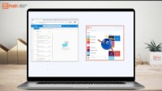
What is a UiPath Software Robot?

Slide 4
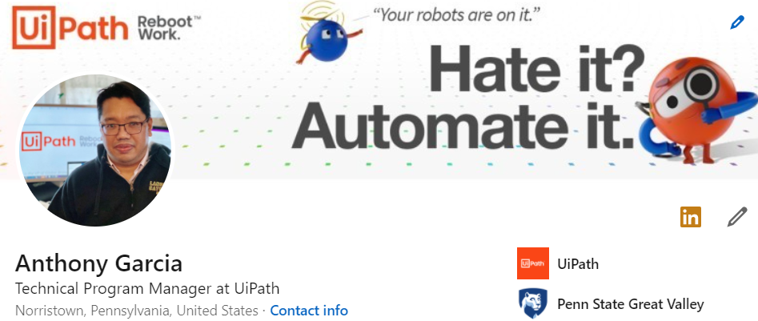
About Me Some UiPath Highlights
As a pre-sales technical consultant, represented UiPath at CIO conferences and technical sales calls including one of the top-10 largest deals at UiPath in 2019.
As a technical project manager, diverse implementations under my belt including a test suite pilot for the government and a large healthcare invoice processing project using artificial intelligence models.
Building internal bots (we practice what we preach) and PM a dev team to contribute to our bot store.
Working with talented teammates around the globe daily who all embody our culture of . . .
HUMBLE
BOLD
IMMERSED
FAST

Slide 5














Start with a bold vision.
BOLD
All Angles
The Business User
The Independent Artist
Mentorships
Placements
Alyssa Garcia
Performances

Slide 6
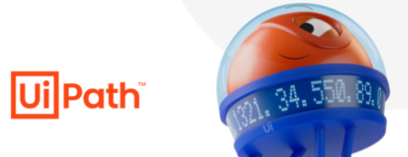







A battalion of robots to help creatives so they can focus on… creating
BOLD
All Angles
Insta Follow Please ☺
@alyssaggarcia
Alyssa Garcia
Maintaining & Monitoring Socials
Time Consuming Work
Competing Approaches

Slide 7
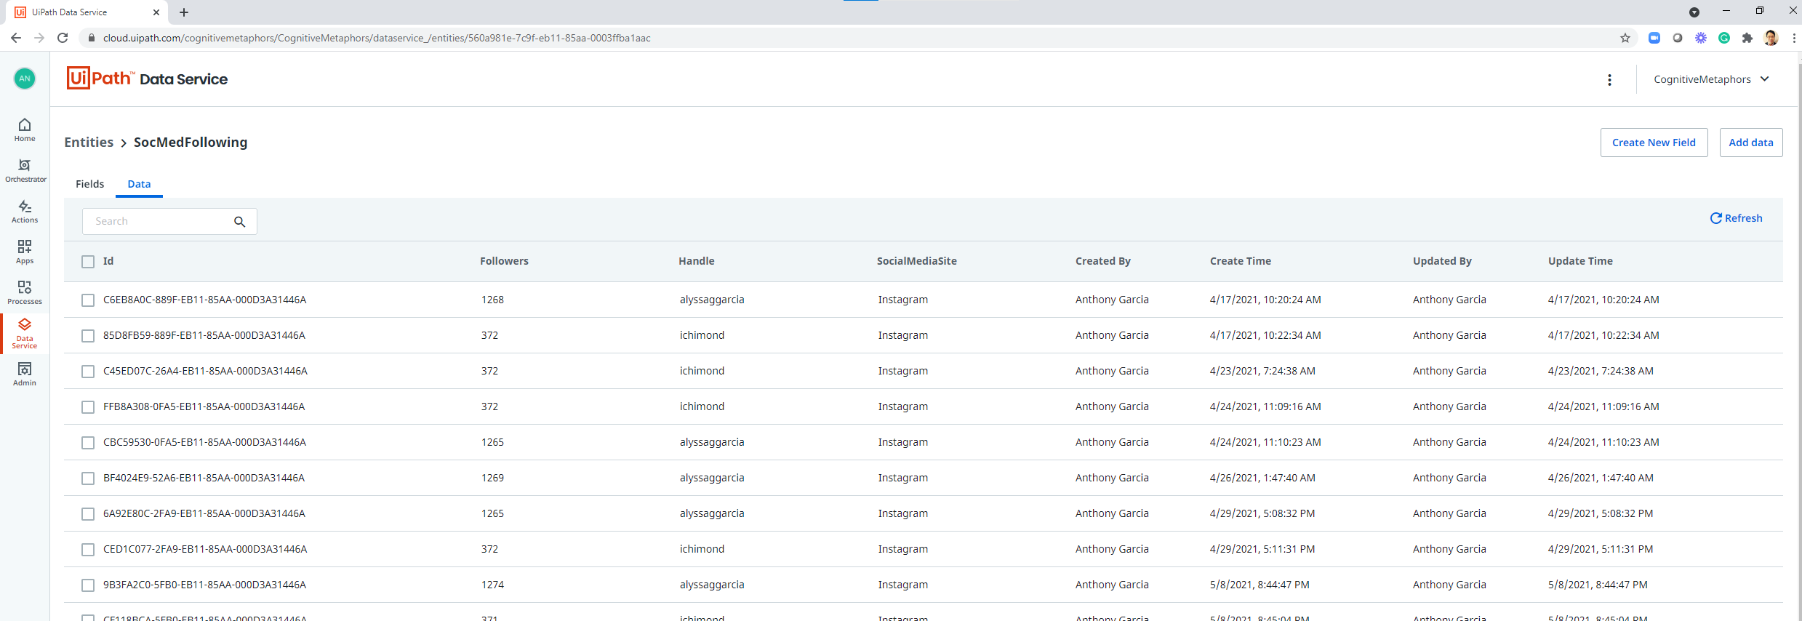
DEMO After you’ve taken some basic courses, get started with a few building blocks. A minimum viable product for tracking social media follower growth.
FAST
Demo

Slide 8
Open up your idea to others with the humblest of intentions.
HUMBLE
GITHUB
Youtube Tutorials
Live Community Talks
Code Reviews / Bug Finders
Notes:
Account Executive – he/she has convinced your customer to spend money on product and services. They are hopeful that successful services work will lead to more product and service sales. They are promising the customer to transform their business and a return on investment.
Production Support – they can augment Infrastructure on quirky customer environment specific issues that cause installs or product not to work right.
Outside Professional Services – They may have worked with the client or similar projects. They are also a good objective viewpoint on your approach.
Business Analyst - I would say in chess terms, middle to end game, the business analyst can drive process design documents once the PM and Solutions architect have done some discovery and have agreed scope. The business analyst needs to paint an accurate AS-IS picture as well as the TO-BE picture. The level of detail must be enough for the customer to understand value and for the developer to produce automations without too much additional discovery. They also play a role in Business Analyst training.

Slide 9
Keep building towards the vision addressing small and larger obstacles along the way… One bug.. One feature at a time…
IMMERSED
Solicit More Ideas From Artists
Add Other Social Media Trackers
Create Web or Slack Based App
Automate Deployment and CI/CD Tests for Scale
Notes:
Account Executive – he/she has convinced your customer to spend money on product and services. They are hopeful that successful services work will lead to more product and service sales. They are promising the customer to transform their business and a return on investment.
Production Support – they can augment Infrastructure on quirky customer environment specific issues that cause installs or product not to work right.
Outside Professional Services – They may have worked with the client or similar projects. They are also a good objective viewpoint on your approach.
Business Analyst - I would say in chess terms, middle to end game, the business analyst can drive process design documents once the PM and Solutions architect have done some discovery and have agreed scope. The business analyst needs to paint an accurate AS-IS picture as well as the TO-BE picture. The level of detail must be enough for the customer to understand value and for the developer to produce automations without too much additional discovery. They also play a role in Business Analyst training.

Slide 10
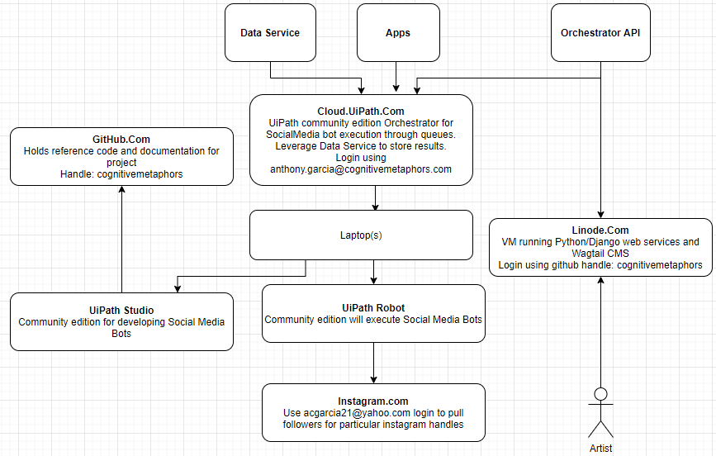
Meet Deathstar 2.0…
IMMERSED
All Angles
Minimum Viable Product that...
Gives a basic understanding of Orchestrator - config file, scheduling, queue
Gives a basic understanding of a production ready UiPath Studio project including:
REFramework
Use of Queues
Selectors
Exception Handling
Retries
Workflow Analyzer for code review
Use of a code repository like Github and CI/CD
Continuous testing using Test Suite
Notes:
A starting architecture to support a platform agnostic bot framework for artists to sign up, learn about, and use bots so they can focus on creating.
I call it Deathstar 2.0 because it is a refocus and consolidation of several pet projects that never got too far off the ground…

Slide 11
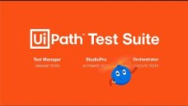
Transform Test Teams from Cost Centers to Value Centers…
UiPath Test Suite: Make Every Application and Robot Resilient

Slide 12


Why is scaling automation so difficult? (DEMO)
<15%
of organizations are actively scaling their automation program
(Deliotte Intelligent Automation Survey 2020)
Automations Stop Working
High
When an automation stops working, it
1
Disrupts the business
Turning Point
Continuous Testing with Test Suite
2
Leads to unplanned maintenance
3
Drives down ROI
Total Savings
Automation
Honeymoon
Low
Few
Many
Automated Processes
Notes:
The goal is a fully automated enterprise
But scaling is hard. In a recent study EY found that upwards of 50% of initial automation projects fail. Why?
There are many reasons automation projects fail, lack of executive support, automating the wrong use cases or poor business involvement, but in working with our customers, we found the main reason automation projects fail is because the automations stop working.
We have found that automation projects tend to see rapid results with obvious, well defined processes like invoice processing... This is the honeymoon period where we see rapid ROI. The automations do stop working - when they encounter exceptions, but the maintenance is not overbearing and can usually be absorbed.and rapidly addressed and redeployed. Then as new and more complex processes are automated the maintenance burdon grows and begins to slow the pipeline of new automations delivered, this is the turning point where ROI begins to flatten.
When automations stop working there are many consequenes:
The business is disrupted – if automated onboarding stops working, HR has to drop everything and revert to manual onboarding
A developer will have to drop what they are working on and address the issue as fast as possible
As we mentioned, the overall ROI of the project will be impacted in both the business and the ability to deliver new automations
So why do automations stop working? Let‘s explore...
(Alternative to 50% statistic -> Only 3% of organizations have been able to scale their digital workforce)

Slide 13

UiPath Test Suite: Build faster. Test continuously. Maintain (almost) never.
“With UiPath Test Suite, I was able to automate the work of 3 testers with 1 UiPath Test Robot. We are on the path to be efficient enough to improve release velocity by 2 months.”
Reduce RPA and test automation maintenance by 50% (Based on documented studies by Impower.ai and Testing Experts)
50%
A top 5 U.S. healthcare provider
10X
Deploy new RPA automations to production 10 times faster. (Baaed on documented customer study with Impower.ai)
“New capabilities such as Test Suite enables us to achieve regression testing with efficiency through storing and tracking of test data.”
Krishna Devineni, Lead Software Engineer
Component reuse by customers using UiPath in Test and RPA teams. (Baaed on documented customer study with Impower.ai)
66%
Notes:
The results so far have blown us away. All of these metrics were gathered by two trusted business partners, who benchmarked customers before and after they adopted RPA testing for their workflows.
As we mentioned earlier, they found that customers have reduced the time they spend on maintaining automations by 50% - applies to both application and process testing. This really accelerated their ability to build new automations.
Because RPA testing is built-in, customers have streamlined their deployment processes and can now deploy automations ten times faster than before.
And finally, one of the biggest values of using Test Suite across the Enterprise is the ability to share and reuse components. Our customers have found that upwards of 66% of components are being reused. Further accelerating the automation delivery and accelerating scaling effort.s
(If application testing is in the room: Call out the quote in the upper right, this is a major healthcare provider who has had great success testing EPIC with Test Suite. EPIC is basically the SAP of Healthcare)
(Source files for metrics: Copy of TestSuite_Experiment.xlsx)

Slide 14

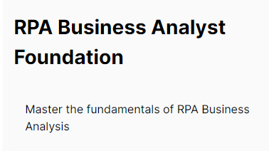
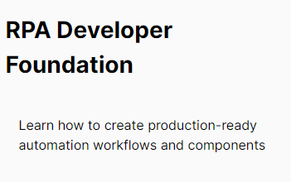
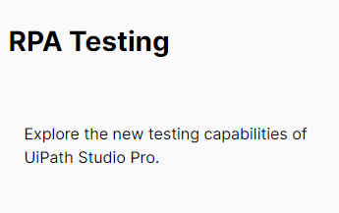
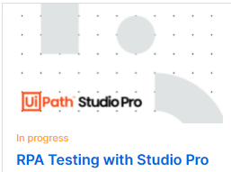
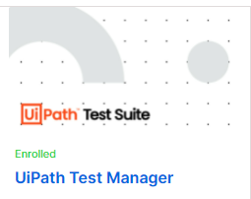
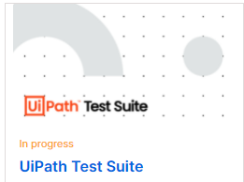
Some good starting courses on Academy.UiPath.Com…

Slide 15

Going on in the Philippines…
The UiPath Manila Chapter
https://community.uipath.com/manila
Local UiPathers You Need To Know
Russel - https://www.linkedin.com/in/russel-alfeche/
Ferdie - https://www.linkedin.com/in/ferdiemac/

Slide 16
More Questions?
Keep in touch…. https://www.linkedin.com/in/acgarcia21/
Code / Presentation Demoed Today
https://github.com/cognitivemetaphors
Repositories:
SocialMediaBots
SocMedPerformer
SocMedDispatcher

Slide 17
























The UiPath automation platform
End-Users
Process Analysts
Automation & Citizen Developers
IT Operations
Business Users
Business Analysts
UiPath Automation Platform
Discover
Build
Manage
Run
Engage
Measure
Discover automation opportunities powered by AI and your people
Build automations quickly, from the simple to the advanced
Manage, deploy, and optimize automation at enterprise scale
Run automations through robots that work with your applications and data
Engage people and robots as one team for seamless process collaboration
Measure operations and performance to align with business outcomes
Existing Applications
Example Systems of Record: On-premises and SaaS applications
Mainframe applications
Homegrown applications

Slide 18



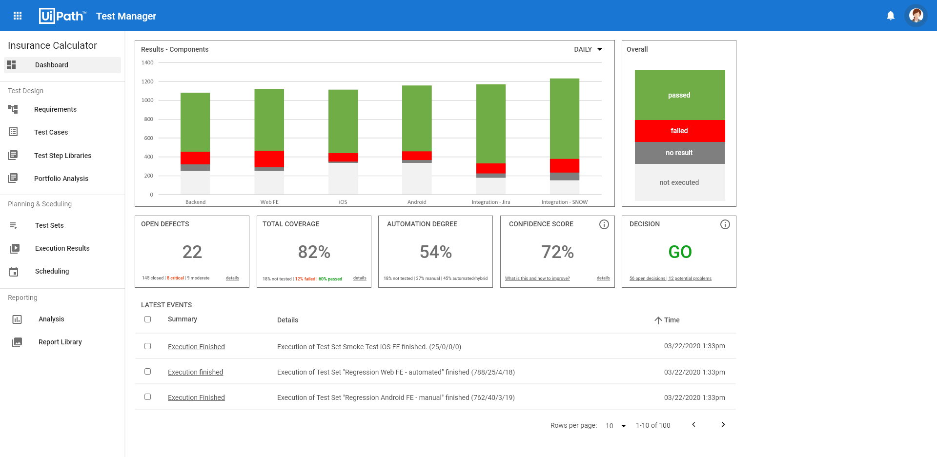
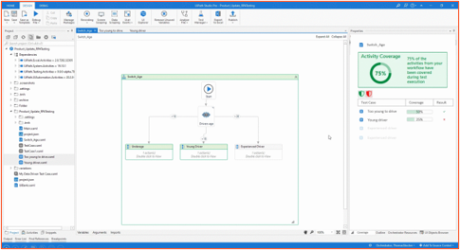
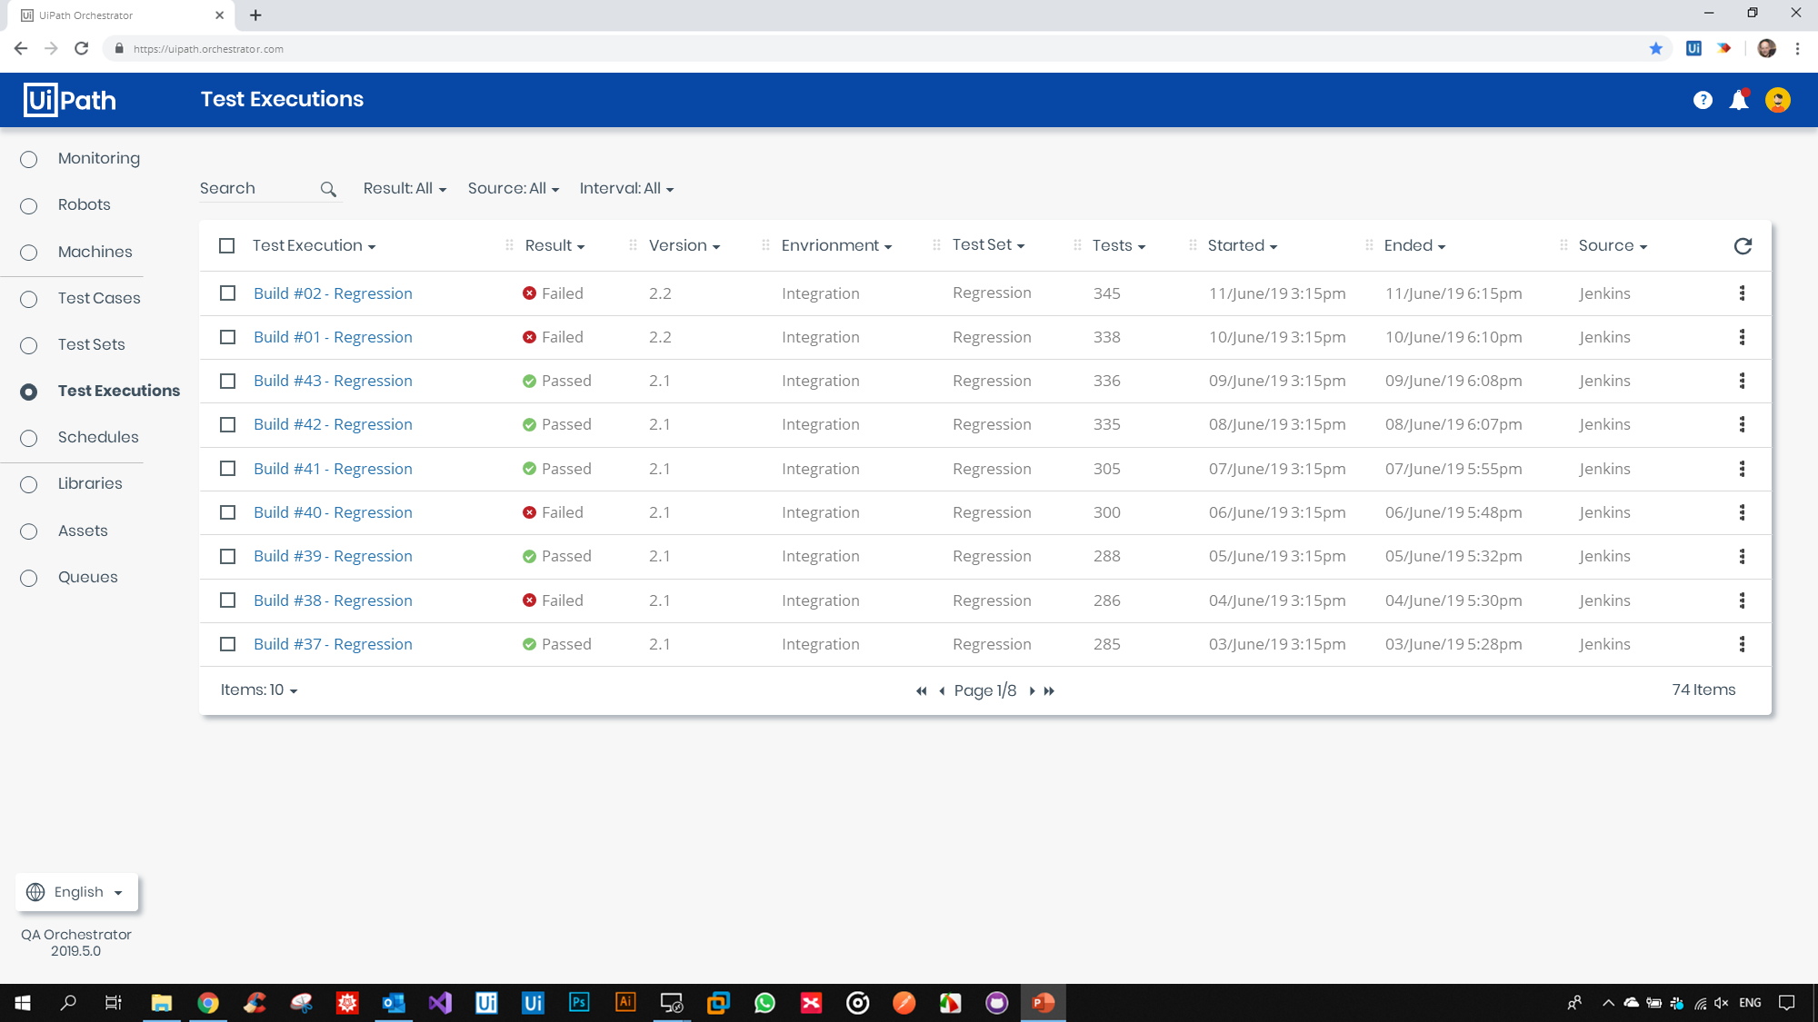
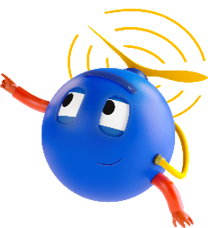









UiPath Test Suite Family of Products
Manage Testing and Analyze Results
Automate Tests & Test Automations
Schedule and Execute Automations
RPA
Production-grade automation, AI and orchestration brought to Testing
Automate any UI or API technology
API
Share and reuse automations with the entire enterprise
Seamlessly integrates into your ALM and DevOps toolchain
Notes:
Test Suite is a family of products that include Test Manager, Studio Pro and Orchestrator.
Test Manager is used to plan and monitor testing for automations, applications, or environments. It enables testers, developers and analysts to rapidly triage defects with full requirements traceability and visual logging while providing automation leaders with a dashboard to monitor overall automation quality. It is simple to use and connects to your application lifecycle management (ALM) toolchain with connectors to SAP Solution Manager, ServiceNow, Azure Devops and Jira – in addition we provide an integration SDK to build custom integrations.
Studio Pro is where developers automate tests and test automations. Whether you’re testing RPA workflows, web apps, SAP, Citrix or mobile, Studio Pro has you covered with its low-code interface and hundreds of prebuilt activities. In addition, Studio Pro enables data driven testing and has purpose built features to support RPA testing with activity coverage tracking and activity mocking (which we’ll see in the demo). All test cases automated in Studio Pro can be published to Orchestrator for distributed test execution.
Orchestrator is the same production-grade product used by thousands of UiPath customers. With Test Suite, we’ve added test orchestration capabilities, including the ability to organize Test Cases into logical groupings called Test Sets, these Test Sets can be setup to run or via CI/CD triggers with integrations to Jenkins or Azure DevOps. It is Veracode certified, provides full audit trails, centrally manages credentials and assets.
Test Suite is unlike any test or RPA tool on the market, it is production-grade, which makes it more reliable than traditional test tools, it can automate testing of almost any UI or API technology and when used across the enterprise, all of the components and objects can be shared and reused, further accelerating automation scaling.

Slide 19

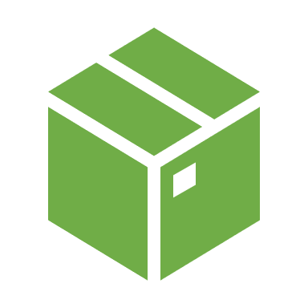

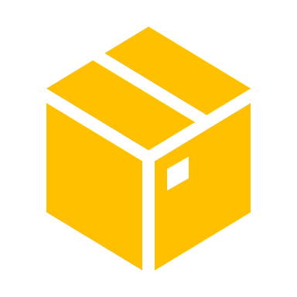





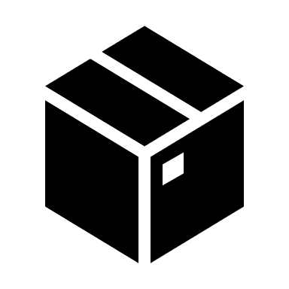
RPA Testing, Source Control and CICD – Simple Scenario
Test Suite
CI/CD Tool (Jenkins, Azure DevOps, etc.)
Tests Pass
Version Control System
(GIT, SVN, TFS)
Production
Functional Bots
Test
Commit Changes
Functional Workflows
Test Robot Runs Tests
Unit Tests
Testing Bot Results
Testing Workflows
Test are committed to VCS
CI/CD Tool Creates NuGet Package for Orchestrator
Test Robot Performs Tests and Results are reported back to CI/CD Tool
CI/CD Tool will confirm or revert commit based on Test Results (Optional)
CI/CD promotes or rejects build
Developers
Robot Workflow NuGet Package
Test Robot Workflow

Slide 20
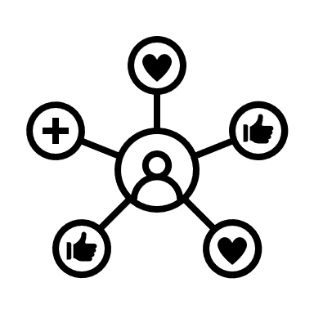
RPA Testing, Source Control and CICD - Second Scenario
Test Suite
Functional Bots
Test
Production
CI/CD Tool (Jenkins, Azure DevOps, etc.)
Testing Bot Results
Testing Bot Results
Version Control System
(GIT, SVN, TFS)
Development
Test
Production
Promote
Promote
Commit Changes
Test are committed to VCS
CI/CD Tool Creates NuGet Package for Orchestrator
Test Robot Performs Tests and Results are reported back to CI/CD Tool
CI/CD Tool will confirm or revert commit based on Test Results
COE decides to promote or reject build
Functional Workflows
Unit Tests
Testing Workflows
Developers

